Slide 1
Assembly reflects evolution of protein complexes
2008/8/8 zhen JC
Emmanuel D. Levy, Elisabetta Boeri Erba, Carol V. Robinson & Sarah A. Teichmann

Slide 2
Most proteins interact with other proteins and form protein complexes to carry out their function.
A recent survey (Galvin 2006) of ~2,000 yeast proteins found that more than 80% of the proteins interact with at least one partner.
Unifying principles of evolution and assembly are needed:
hierarchical classification of protein complexes
Evolution path (how to assemble from monomer)
Disease association (sickle cell, Aldolase A D128G causes hemolytic anemia, ALDH2 E504K alcohol intoxication in orientals)

Slide 3
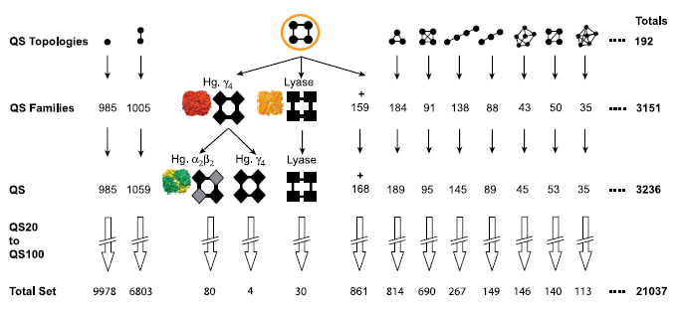
A Structural Classification of Protein Complexes
Graphical representation
SCOP domain architecture
5375 homomers
non-redundant at 80% sequence identity
Sequence similarity and sysmetry

Slide 4
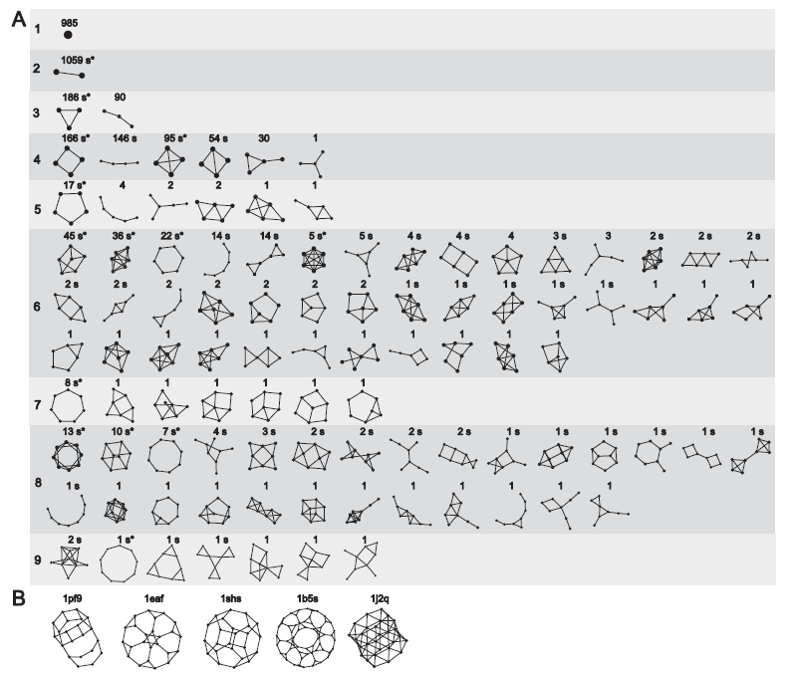

Slide 5
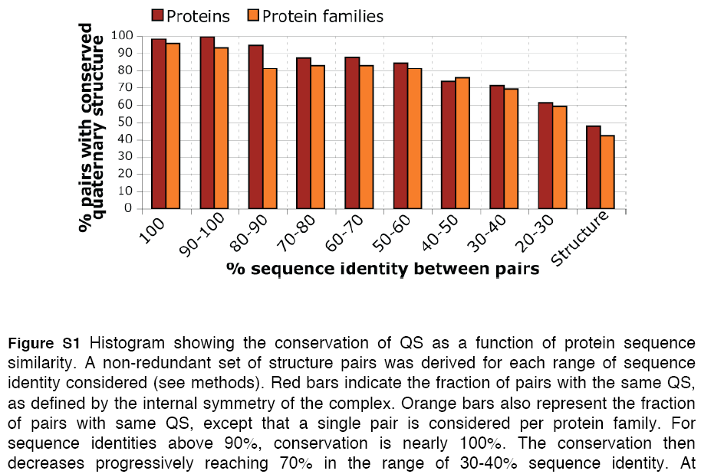
Basics 1: Sequence- complex conservation

Slide 6
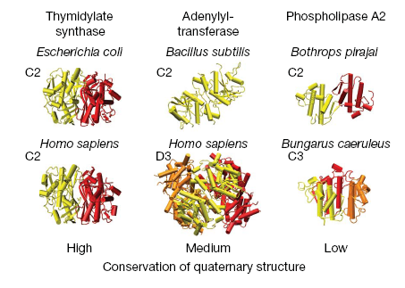

Slide 7
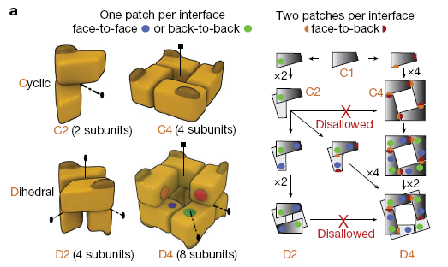
Symmetry: Cn as a cyclic complex containing n subunits, and Dn as a dihedral complex containing 2n subunits

Slide 8
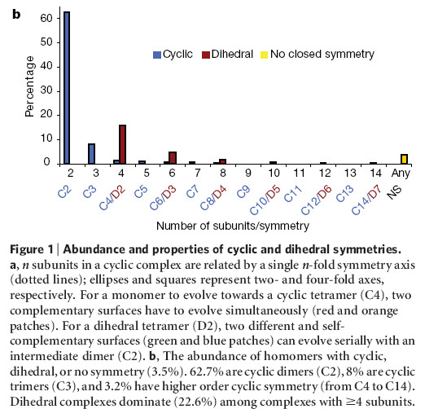
smaller complexes are more abundant than larger ones, and even numbers of subunits are favoured over odd numbers. Whenever an option exists for cyclic or dihedral, on average we find an 11-fold preference for dihedral complexes

Slide 9
Explanation for the preference on dihedral complex
First face-to-back interactions are less likely to form by random mutation and
second, at the level of whole complexes, evolution of dihedral complexes can take place in multiple steps (C1->C2->D2) whereas cyclics must evolve in one step (C1>C4)

Slide 10
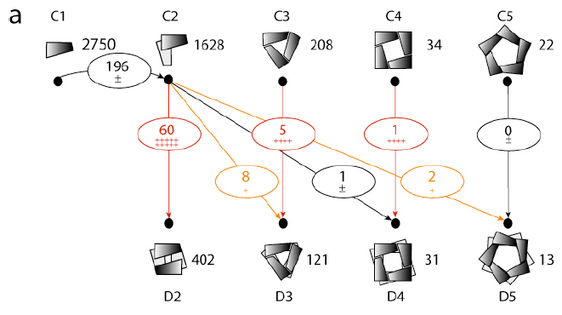
The evolutionary relationship (sequence similarity) between different QS
For each evolutionary link between two quaternary structure types, a first quaternary structure type is picked up with a probability p(QS)=T^{QS} / T, where T^{QS} is the quaternary structure size (number of proteins), and T is the total number of proteins. A second quaternary structure is chosen in the same way but the type picked first is set aside and cannot be selected again. One-hundred rounds of reassignment were performed, and a mean number of links and associated standard deviation were calculated for each quaternary structure pair.

Slide 11
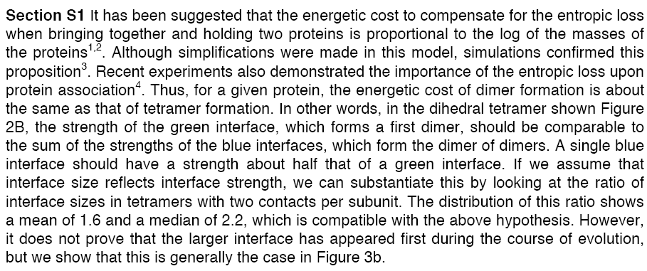
Hypothesis of evolutionary route from energetic consideration
They propose that a hierarchy of interface sizes exists within dihedral complexes, and that the larger interface is conserved in evolution.

Slide 12
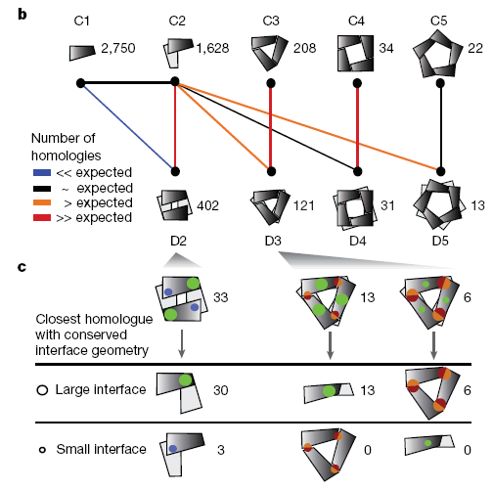
Evolutionary route of a homomer can be predicted solely from its interface sizes.
Details

Slide 13
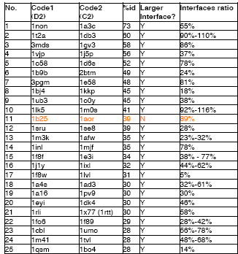
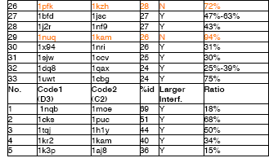
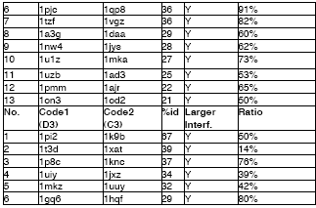

Slide 14
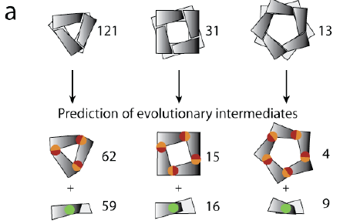
Prediction for D3 D4 D5

Slide 15
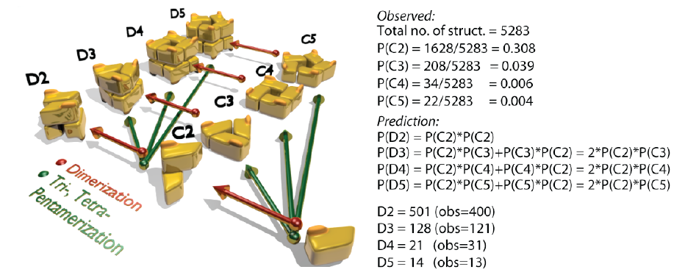
prediction of evolutionary routes or intermediates

Slide 16
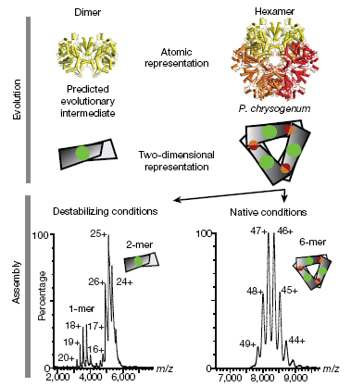
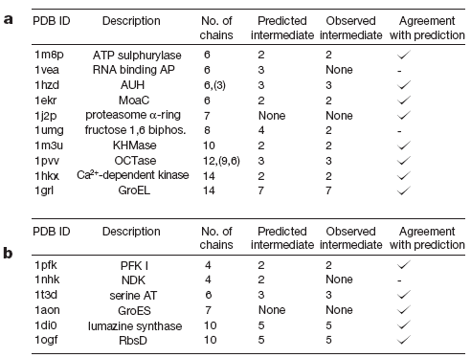
Validation of the patch size hypothesis
These results demonstrate that the largest interface is maintained consistently during disassembly.

Slide 17
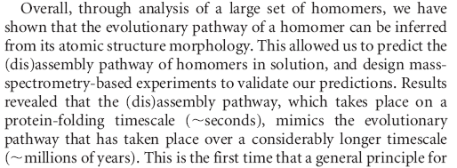

Slide 18
